Slide 1
Flight price prediction
Lalbiak Zauva

Slide 2
AGENDA
Problem statement​
Data Analysis (EDA)
​Data preprocessing
Model building
​Conclusion

Slide 3
Problem statement
Flight ticket prices can be something hard to guess, today we might see a price, check out the price of the same flight tomorrow, it will be a different story.
We might have often heard travellers saying that flight ticket prices are so unpredictable. Here I have scraped prices of flight tickets for various airlines during 30th September till 8th October 2022 and between various cities.

Slide 4
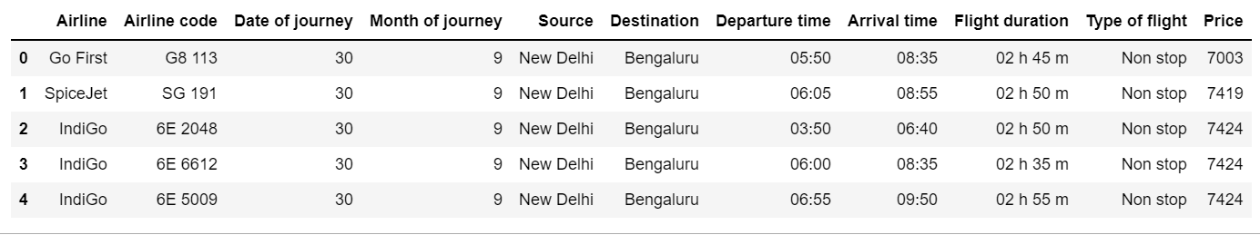
Exploratory data analysis
Data is collected by a method of web scraping using selenium from the website
https://www.makemytrip.com/
Total number of rows = 1213
Total number of columns = 11

Slide 5
Exploratory data analysis
There are no null values, so we need not fill them.
There are 8 columns which are of obj data type; while there are 3 columns which are of int64 data type.
Using .describe() function, the data looks fine in terms of skewness but there might be some skewness, so we need to be sure about this and deal it later.
A scatter plot is used to see the relation between each feature and the target.

Slide 6
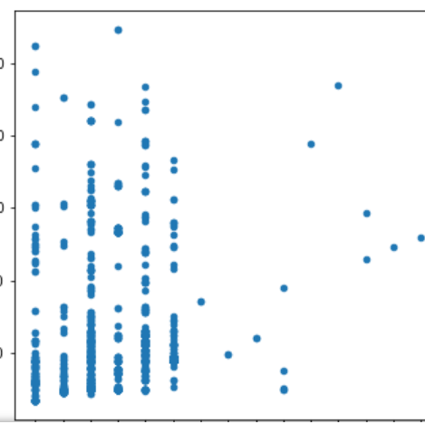
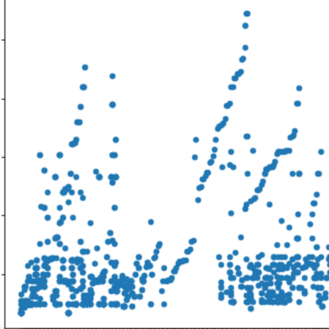
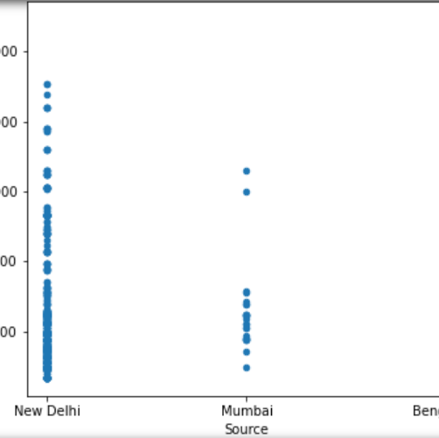
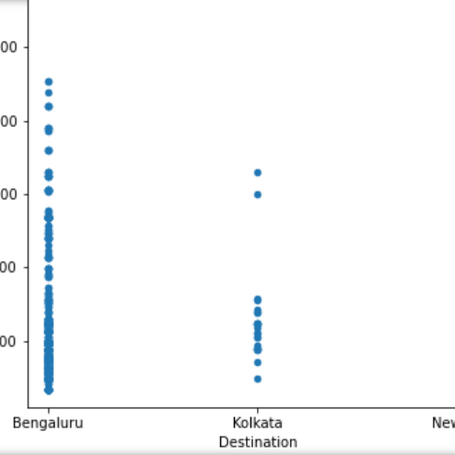
Exploratory data analysis
Airline
Airline code
Source
Destination

Slide 7
Exploratory data analysis
Flights which offer lower prices are chosen by passengers more frequently.
If source is Delhi, then price is cheap and this may be the reason there are so many flights for passengers since people are attracted by cheaper prices.
Flight duration which are longer tend to have higher price.

Slide 8
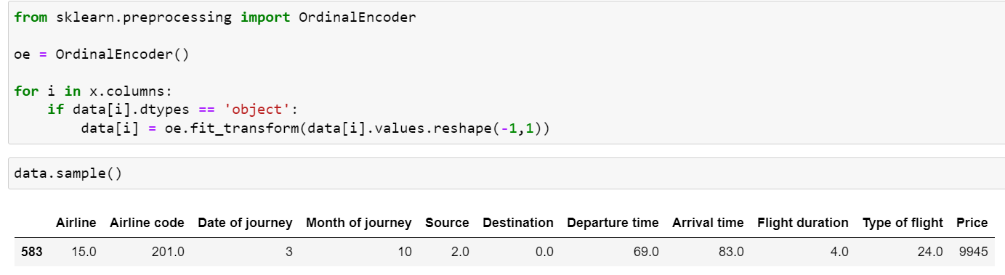
Data pre-processing Encoding the data
The categorical columns needs encoding since machine only understand numbers and not object data type. So, they are encoded using Ordinal Encoder.

Slide 9
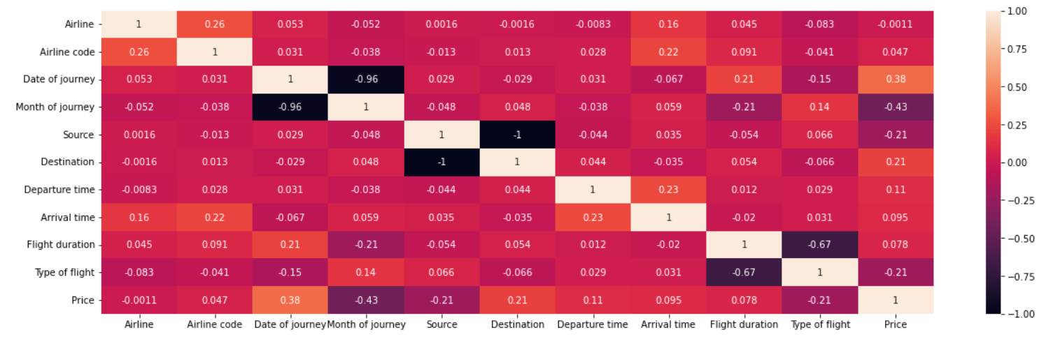
Data pre-processing Checking multicollinearity
We now will check for multicollinearity which means that if there are correlation between the features, we will remove one of them.
It seems like there is no multicollinearity.

Slide 10
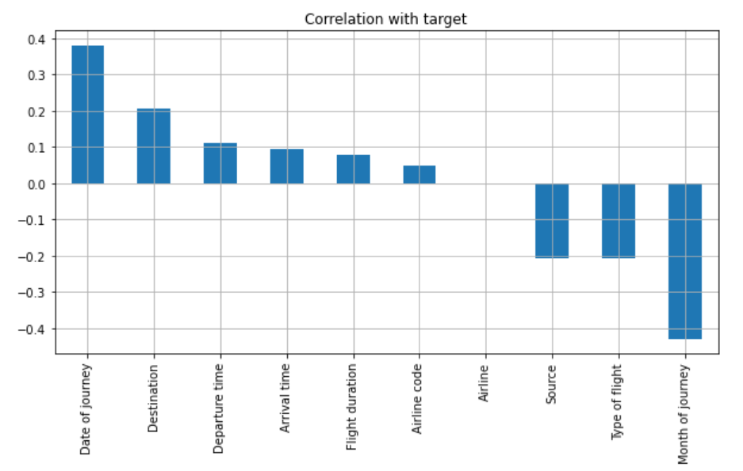
Data pre-processing Checking correlation with target
We will check correlation between features and target and see which features are more important than the others.

Slide 11

Data pre-processing removing skewness
Let’s use log transformation to remove the skewness in the data for continuous data.
Since data cleaning process is done and we have done the analysis, let’s build our machine learning model to predict the prices of flights.

Slide 12
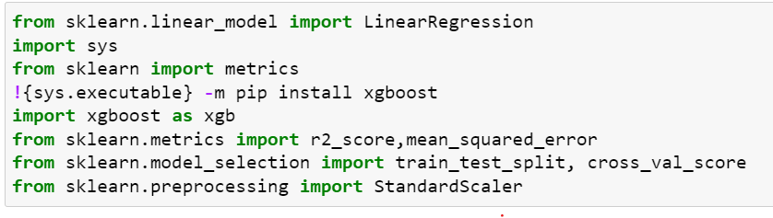
Model building
First we need to import necessary libraries.
We need to split the data into train and test data and then test for the best machine learning algorithm which gives the best accuracy.

Slide 13
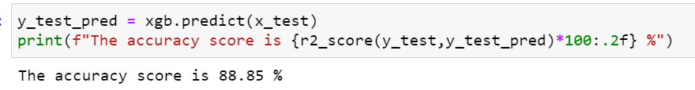
Model building
Since ours is a regression problem, we will calculate the R2 score.
Out of different algorithms, XBGRegressor works best which gives an accuracy of 88.85 %.
After tuning the parameters, the accuracy slightly improved to 89.11 %. Here RandomizedSearchCV is used.

Slide 14
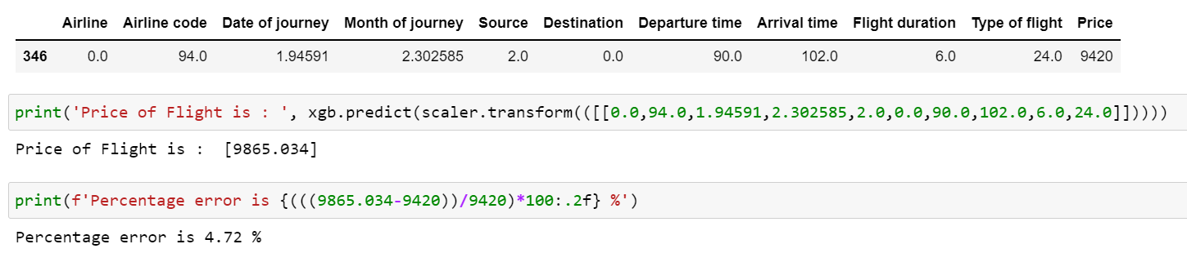
Testing the model
Now, we take one sample data and try to predict the price and then compare with the actual price and see how close we get.

Slide 15
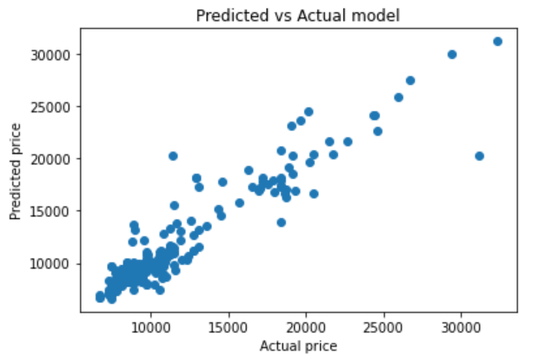
Predicted vs actual
A scatterplot of predicted and actual price is plotted.

Slide 16
Conclusion & further improvements
We now know that flight prices depends on various factors, and they changes frequently.
The route also plays an important role in the price of the flight. Longer routes costs higher than shorter routes.
Since I have collected only 1213 records, the model could perform much better if there are more data to train to.
The range of the month from which the data is collected could be increased, and also more cities could be added given the time.

Slide 17
THANK YOU
Lalbiak Zauva
bbiakzauva@gmail.com

